Slide 1
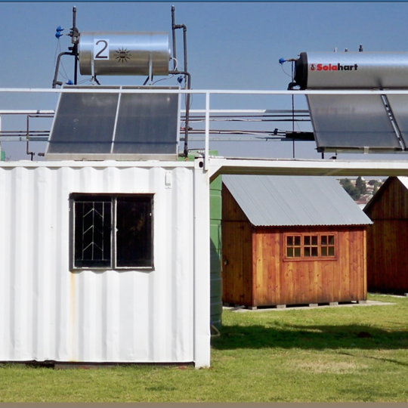
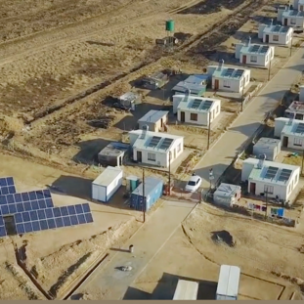
Clarification Meeting – Contracts Management
Project name:
Lifting equipment for Central East cluster
Presented by: Lucky Motse
Date: 08 February 2024

Slide 2
NEC
A type of contract that will be used for this work is TSC3
The contract comprises of the following:
Part C1 agreements and contract Data
Part C2 Pricing Data
Part C3 Scope of work
Take note: X and Z clauses will apply but there is selected X-clauses that will be used specifically to the contract(TSC3).

Slide 3
Pricing
Bill of Quantities will be used for this projects as a form of pricing.
All activities in the BOQ need to be priced
Make sure that you read the BOQ concurrently with the Specification of the equipment when you price.
Make sure that your pricing is market related.

Slide 4

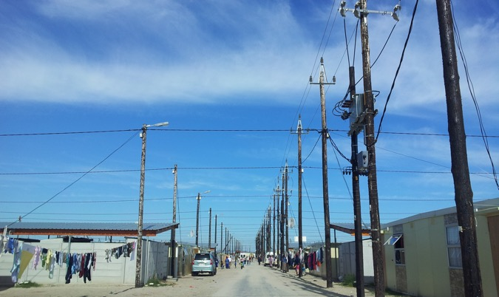
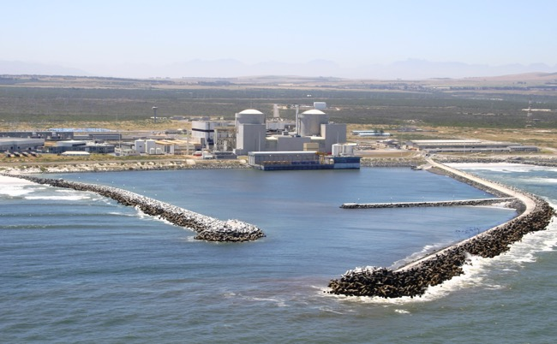
FSOU is looking forward to working with you.
Thank You

