Slide 1
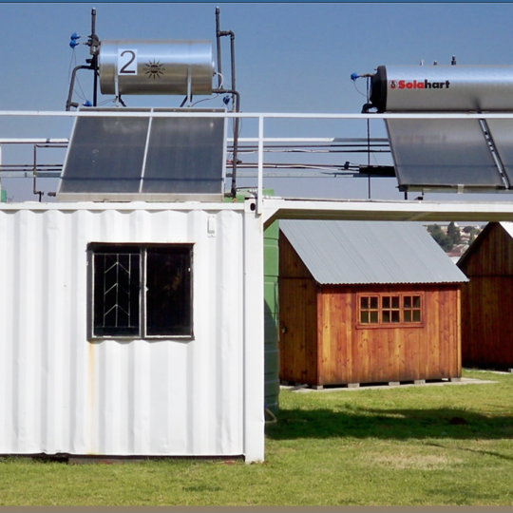
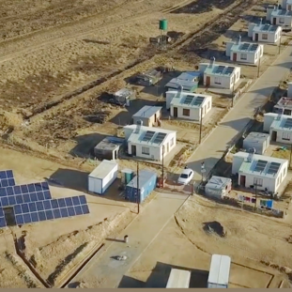
Environmental Requirements
24 April 2023

Slide 2
Introduction
OBJECTIVE
The objective of this presentation is to clarify environmental requirements for tender submission.
The bidder shall demonstrate the ability to perform work in an environmentally sustainable manner (Avoid/or minimize environmental damage )
LEGAL CONTEXT
The bidder shall take note of all relevant applicable South African Environmental Legislation e.g., NEMA, SEMAs
May be required to obtain relevant Environmental permits for gas infrastructure from the seaport to the power plant.
OTHER REQUREMENTS
Environmental Specification
Provincial By-Laws
Municipal Bylaws
PS Standards Procedures

Slide 3
Environmental Specification (document no. 240-158699799)
Sets out the minimum environmental requirements.
The Contractor should peruse this document to plan for this bid
Execute works in accordance with this document as well as other applicable legal documents.

Slide 4
Environmental Specification (document no. 240-158699799)
Section 6.6.1.1 Appoint a Site Environmental Officer with the following criteria:
  An environmental tertiary qualification e.g., BSc Environmental Science, Honours degree, BTech, N Diploma (Nature Conservation) or a related field;
  Minimum of two (2) years appropriate working experience;
  Successful completion of an accredited and comprehensive South African Environmental Legislation course;
  Working experience on on-site environmental compliance monitoring and auditing during construction;
  Working experience on reporting of environmental compliance;
  Working knowledge and relevant exposure to environmental management policies, standards, policies and legal compliance;
  Good writing and verbal communication skills in English.

Slide 5
Environmental Specification (document no. 240-158699799)
Section 6.19 Dangerous Goods & Hazardous Substances:
  Material Safety Datasheets (MSDS)
  Method statements must be developed and approved
  Any spillages that occur shall be cleaned
  Appropriate storage areas
  Oil traps must be pumped out regularly and remain free of debris;
  Drip trays

Slide 6
Environmental Specification (document no. 240-158699799)
Section 6.9 Method Statements
Section 6.38 Borrow Materials
  source borrow materials from licensed borrow areas as approved in terms of the Minerals and Petroleum Resources Development Act (No 28 of 2002), NEMA and have respective Water Use Licenses (if applicable).
  Record Keeping
Section 6.39 Rehabilitation
  Appoint a suitably qualified rehabilitation/ botanical/ horticultural specialist to compile a rehabilitation plan and oversee the rehabilitation process during and after the construction of the BESS.

Slide 7
Environmental Specification (document no. 240-158699799)
Section 6.31 Waste Management
  Waste management plan must include the following (but not limited to):
    The waste class and rating in order to determinate correct disposal method for the waste and any other best practice that may be necessary to give effect to the requirements of the National Environmental Management: Waste Act and regulations passed thereunder;
    Approved/ licensed waste disposal sites to be used;
    Audited Records of waste quantities disposed (Template); and
    Identified compliance obligations.

Slide 8
Environmental Specification (document no. 240-158699799)
Section 6.36.4 Scheduled Items
Provide costs for the following items:

Slide 9
Tender Returnables (Section 7 of 240-156088485)
Environmental Management System (EMS) ISO 14001:2015
Provide a copy of your Company Environmental Policy statement (refer to section 6.2)
Provide a detailed plan on how you are going to implement the EMS (refer to section 6.3)
Provide an Aspects and Impacts register for the works and specific technology solution to be undertaken (refer to section 6.4)

Slide 10
Tender Returnables (Section 7 of 240-158699799)
1 Environmental Management Plan
Provide a detailed plan on execution and compliance with this Environmental Specification. The following should be included, but not limited to:
  Draft Construction Layout drawing as per section
  Site Establishment Procedure as per section
  Waste Management Plan Water Management Plan including Stormwater Management Plan.
  Vegetation Management Plan
  Environmental Incident Management Procedure (including emergency situations)
  Training Procedure for Environmental Management
  Compliance monitoring and auditing Procedure
  Method statement related to hazardous substance/dangerous goods
  Site Closure Procedure and details about rehabilitation

Slide 11
Tender Returnables (Section 7 of 240-158699799)
Draft Construction Layout Drawing as per section 6.9.1
The following information shall be included:
  Location of key infrastructure and services required for construction, including but not limited to offices, overnight vehicle parking areas, stores, the workshop, stockpile and laydown areas, hazardous storage areas (including fuels), the batching plant/s, designated access routes, equipment cleaning areas and the placement of any staff accommodation, cooking and ablution facilities;
  Location and structure of the fuel storage area, including the types of fuel and volume of storage container/s and the design and capacity of the bund;
  Location and layout of concrete batching facilities;
  Location and layout of the waste holding area and waste bins across the Site;
  Location and layout of temporary storm water management controls;
  All sensitive features e.g. critical biodiversity areas, ecological support areas, wetlands, storm water channels, wetlands, drainage channels as identified in specialist reports and the EIA;
  All “no-go” and buffer areas.

Slide 12
Tender Returnables (Section 7 of 240-158699799)
2 Environmental Management Plan
Provide proof of EA and EMPr execution and implementation on at least three current or previous completed projects involved in the past 10 years. Examples include independent project audit reports, and closure certificates.
Provide at least four (4) contactable references per project.

Slide 13
Tender Returnables (Section 7 of 240-158699799)
Environmental Fines and Legal contraventions
Declare history of environmental fines, compliance notices and legal contraventions issued to the Contractor or Client over the past 10 years, especially where performance guarantees have been withheld on account of any environmental reason.
Scheduled Items
Provide a price list for all Scheduled Items as per section 6.36.4

