Slide 1
Deep cleaning services required for Eskom Rotek Industries (ERI) at Rosherville
Presented by: Ntokozo Ngubane
Date: September 2026

Slide 2
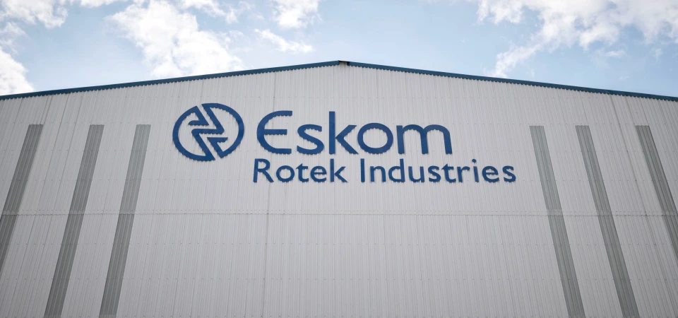
Introduction
ERI responsibility and commitment are to ensure a safe and healthy working environment for all employees and partners including contractors, service providers and suppliers.
This is in line with its Safety, Health, Environmental and Quality (SHEQ) Policy, along with all legislative obligations such as the OHS Act and COID Act.
All work that the organisation embarks on must comply with health and safety requirements as required by the SHEQ policy, OHS procedures and legal requirements.
Therefore, all Eskom’s partners (contractors, service providers and suppliers) must comply with OHS requirements set out for each project.

Slide 3
OHS requirements: tender returnables
Criteria for non-ISO 45001 certified company Criteria for ISO certified company
1. Acknowledgement of Eskom's SHE rules and requirements form (Annexure B) signed and submitted by the tenderer.
2. Safety, Health, and Environmental Plan- A basic plan on how the company implements OHS management system.
3. Baseline OHS Risk Assessment (BRA)
4. Valid Letter of Good Standing (COIDA or equivalent)
5. SHEQ policy signed by CEO/ MD
Acknowledgement of Eskom's SHE rules and requirements form (Annexure B) signed and submitted by the tenderer.
ISO 45001 certificate or equivalent.
Valid Letter of Good Standing (COIDA or equivalent).

Slide 4
Evaluation and award
The tenderer will then be afforded only one opportunity to correct and resubmit within 07 working days after the clarification session and failure to submit by the deadline and failure to meet all the outstanding requirements will render the contractor non-responsive.
OHS Act section 37(2) Agreement and confirmation that the supplier is an employer in his/her own right, with duties as prescribed in the Occupational Health and Safety Act No. 85 of 1993 (“the Act”), as amended, and agree to ensure that all work will be performed and/or machinery or plant used in accordance with the provisions of the Act.

Slide 5
Thank you

