Slide 1
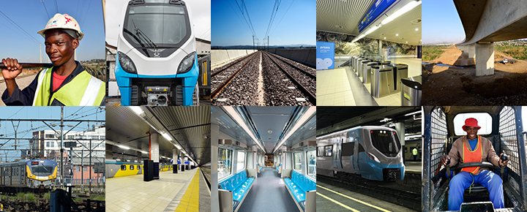

Maintenance Equipment of the New EMUs
APPOINTMENT OF A
SERVICE PROVIDER FOR THE DESIGN, MANUFACTURE, DELIVERY, OFF-LOAD, INSTALLATION, TEST, COMMISSIONING AND TRAINING OF EIGHTY-FOUR (84) ROLLING STOCK MOBILE SYNCHRONISED
VEHICLE LIFTING JACKS FOR PRASA NEW TRAINS
19 August 2026

Slide 2
Background
PRASA’s Rolling Stock Fleet Renewal Programme has delivered over 330 EMU trainsets to date.
This new Rolling Stock fleet requires new or refurbished maintenance depots and modern servicing facilities.
The long-term solution is to modernise and upgrade PRASA’s Rolling Stock maintenance depots through a Depot Modernisation Programme (DMP).
The mobile wheel lathe with synchronised vehicle lifting jacks is part of the medium-term intervention solution to address the much needed safety maintenance intervention for the EMU’s wheels.

Slide 3
Technical Requirements: Mobile Synchronised Vehicle Lifting Jacks
The scope of work for this project shall entail the following activities:
Design
Manufacture
Deliver and Off-Load the Mobile Synchronised Vehicle Lifting Jacks at the depot and place it into the workshop where the lifting of the trainsets will be performed.
Assemble, Test and Commissioning the Mobile Synchronised Vehicle Lifting Jacks.
Training of Maintenance Personnel
Hand-over to PRASA

Slide 4
Technical Requirements: Mobile Synchronised Vehicle Lifting Jacks
Targeted Areas By This Project:
Braamfontein,
Durban Yard and
Salt River Rolling Stock Maintenance Depots.

Slide 5
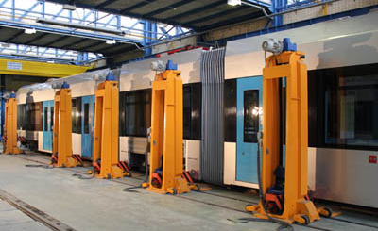
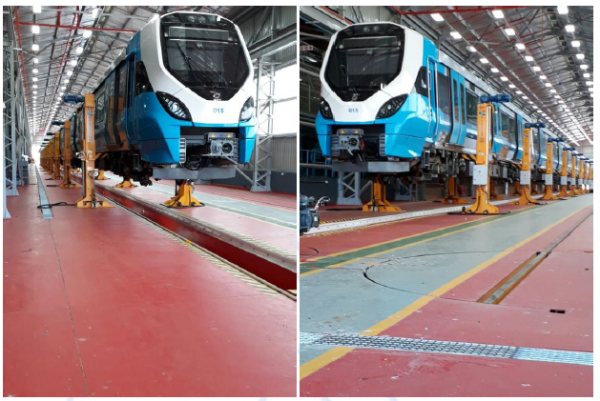
Technical Requirements: Typical Lifting Jacks, EMUs and Workshop

Slide 6
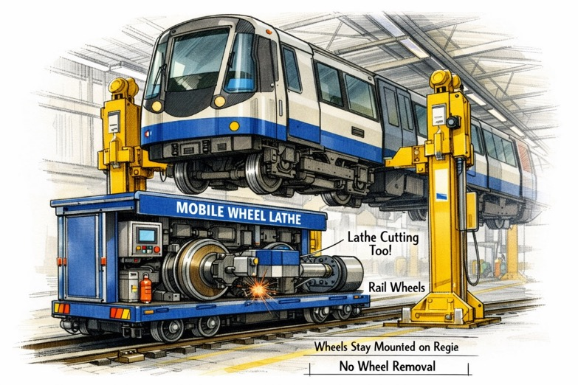
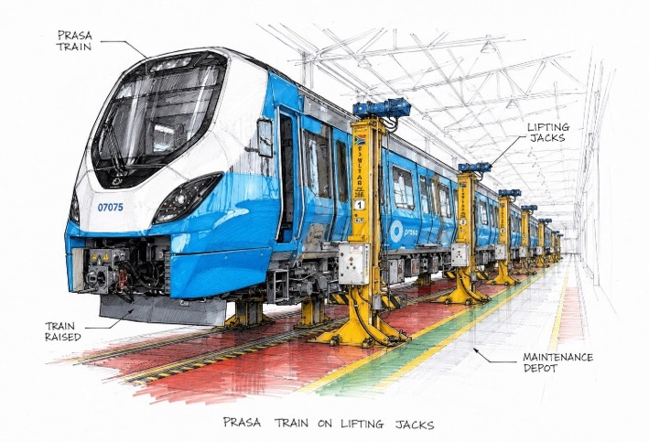
Technical Requirements: Lifting Jacks @ Work

Slide 7
Technical Requirements: Specification of the Work
Product Specification
1.1 User Requirement Specification compliance
Evaluation Capacity of the Bidder
2.1 Track Record Experience
2.2 Delivery Lead Time
2.3 Qualification, Professional registration and Experience of Key Personnel
2.4 Technical Approach and Methodology
2.5 Quality Management Plan / System
2.6 Financial Capability

Slide 8
Payment Milestones: Mobile Synchronised Vehicle Lifting Jacks
DESIGN, MANUFACTURE, DELIVERY, OFF-LOAD, INSTALLATION, TEST, COMMISSIONING AND TRAINING OF EIGHTY-FOUR (84) ROLLING STOCK MOBILE SYNCHRONISED
VEHICLE LIFTING JACKS FOR PRASA NEW TRAINS
# | Description | Date | % of Works | Amount (VAT Inclusive)
DESIGN, MANUFACTURE, DELIVERY, OFF-LOAD, INSTALLATION, TEST, COMMISSIONING AND TRAINING OF ROLLING STOCK MOBILE SYNCHRONISED VEHICLE LITING JACKS FOR PRASA NEW TRAINS
# | Description | Date | % of Works | Amount
1 | Detail Design Approval | [•] | 10% | R [•]
2 | Factory Acceptance Testing (FAT): At source, prior to shipment | [•] | 20% | R [•]
3 | Delivery to site | [•] | 40% | R [•]
4 | Site Acceptance Testing (SAT): Verification against equipment shipped, acceptance and signoff by Engineer/Project Manager | [•] | 20% | R [•]
5 | Release of retention | [•] | 10% | R [•]
Total payments for design, manufacture, deliver, installation, commissioning and training (Contract Price) |  | [•] - [•] | 100% | R [•]

Slide 9
Expected Delivery Schedule: Mobile Synchronised Vehicle Lifting Jacks
Milestone | Date
Tender Advert | Early August 2026
Compulsory Tender Briefing | August 2026
Tender Closing Date for Questions | August 2026
Tender Tender Closing Date for Responses | August 2026
Tender Closing Date | Early September 2026
Tender Evaluations (BEC) | September 2026 to October 2026
Bid Adjudication
Tender Approval as per the Delegation of Authority
Award to successful Bidder | October 2026
Contract negotiation and signing of contract | November 2026
Project Implementation to Completion and Hand-Over | November 2026 to October 2027

Slide 10
THANK YOU

