Slide 1
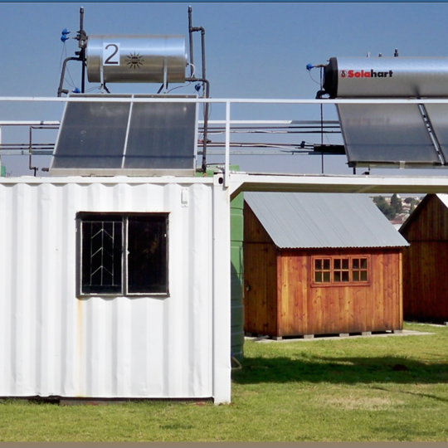
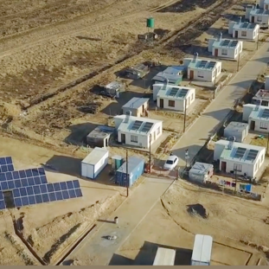
Central East Cluster SHE Criteria
PPU Contract August 2026
Prepared by : Mxolisi Xaba
^{August 2026}

Slide 2
Eskom Values
Our values are the principles that we believe must guide our conduct, the way we work and the nature of our relationship with all stakeholders, internal and external
Eskom will strive to ensure
zero harm to its employees, contractors, the public and
the natural environment
Z – Zero Harm
I – Integrity
I – Innovation
S – Sinobuntu (we are humane, caring)
C – Customer Satisfaction
E – Excellence
To be acknowledged by all
for exceptional standards, performance and professionalism
Honesty of purpose, disciplined conduct, and respect for people
A commitment to deliver products and services that meet our customers’ needs; and to strive to exceed their expectations
Value-adding creativity focused
on results. Leading through excellence in innovation
Caring
“Powering our Province of Legends through Zero Harm – Beware Be Safe Be Alive2"

Slide 3
Eskom’s strategic perspective
VISION
Low cost good investment
A green energy company
The best company to work for
Having satisfied customers
Significant regional player
Offering electricity to all
Zero-harm to people and the environment
A trusted company globally
A top five performing utility

Slide 4
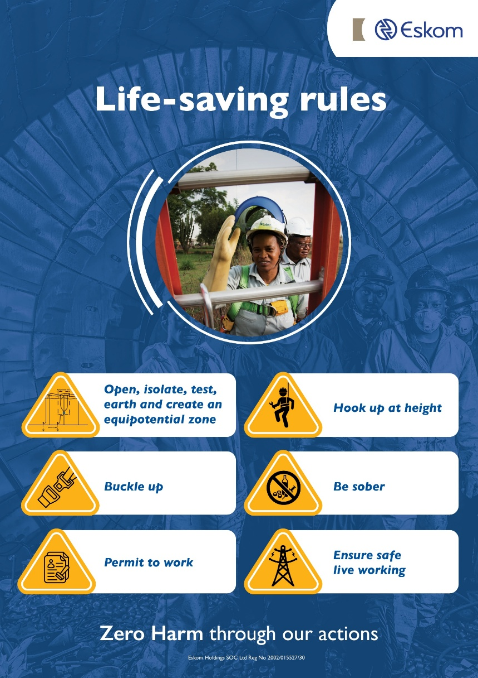
Life-Saving Rules

Slide 5
List of requirements
1. Is the acknowledgement form for Eskom's rules and requirements (in Annexure B) signed and submitted by the tenderer?
- to be sign by the CEO or Director of the company/supplier
- and by both witnesses

Slide 6
List of requirements
2. OH&S Organogram
Approved by CEO/Director)-Including names and appointment references.

Slide 7
List of requirements
3. Health and Safety plan
This must be relevant to the Scope of work of Electrical Work addressing and responding to the Eskom Health and Safety Specification (SHE Plan numbering must align to the left-hand side numbers in the SHE Specification). Review date to be included in the document). To be signed off by the Owner / CEO / MD.

Slide 8
List of requirements
4. Baseline risk assessments
To include next review date) (Approved by CEO/Director).
Include all risks as per the scope of work.

Slide 9
List of requirements
5. Valid Letter of Good Standing
The letter of good standing must state the relevant services rendered by the company, e.g. Electrical
Valid date.

Slide 10
List of requirements
6. SHE policy
-Signed by CEO/Director and have a review date.
Clearly define the intent of the policy
Management commitment and the objectives
Legal and regulatory compliance
Risk management and incident management
Emergency, communication, and continuous improvement

Slide 11
List of requirements
7. SHE Competency; proof of the following training certificates and appointment letters for each of the following. NB accreditation certificate to be provided by training provider for each competency.
Sec. 17 Health and Safety Representative
GSR 3(4) First Aid (Perform Basic Life support training)
CR 29 (H&I) Fire fighter
CR 9(1) Risk Assessor
CR 8(7) Construction Supervisor (With MV/LV line Construction)
CR 8(5) Safety Officer (Registered with SACPCMP)

Slide 12
List of requirements
CR 10(1) Fall protection planner/developer- SANS 229994
Fall rescuer (Competency Certificate)-SANS 229998
GAR 9(2) Incident investigator
CR 13 (1) Competent person for Excavation work

Slide 13
List of requirements
8. Medical Fitness Certificate (including Annexure 3 format) done by Occupational Health Practitioner / Nurse / Doctor (ONLY).

Slide 14
List of requirements
9. Fall Protection Plan as per CR10 (with Rescue Plan & Fall Risks)
(Next Review date to be included and to be signed by CEO/MD)

Slide 15
List of requirements
10. Substance Abuse Procedure
(Submit one Procedure or Policy, Policy must be signed by CEO/Director)

Slide 16
List of requirements
11. Costing for SHE

Slide 17
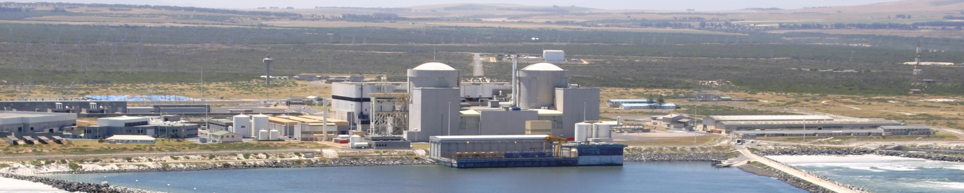
THANK YOU

