Slide 1
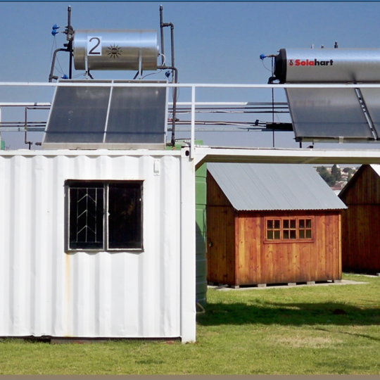
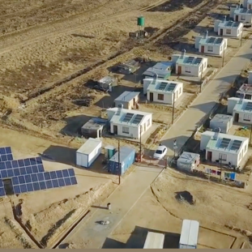
Provision of Major and Minor Reticulation including the installation of smart meters, re-closers and voltage regulators within Distribution Gemma Cluster-Northern Cape on an “as and when” required basis over a period of four (4) years.
28 August 2026

Slide 2
CONTRACT DATA: CORE CLAUSES
A contract will be established with the successful tenderers according to the approval by the relevant authority. The contract terms and conditions will be based on NEC3 Engineering and Construction Contract (ECC3) with Eskom-specific conditions as follows:
The conditions of contract are the core clauses
The Core Clauses 1 – 9
The clauses for main Option
B: Priced contract with Bill of Quantities
Dispute resolution Option
W1: Dispute resolution procedure

Slide 3
CONTRACT DATA: SECONDARY OPTIONS
The secondary options are:
X1: Price adjustment for inflation
It Provides the means for adjusting the price of works to match inflation.
Contract Price Adjustment will be applied monthly/annually where applicable and based on proposed indices.
The contract will be fixed and firm for the first year
and thereafter annual price adjustments will be applied for the remainder of the contract period.
The rates provided in the Pricing Data will apply for the first 12 months after the base date, which is a month before the tender closing date.
From the anniversary date of base date, the rates will be adjusted for inflation using the relevant tables published by the Department of Labour.
Labour rates 60% in the Pricing Data will be adjusted as per SEIFSA TABLE C3.
Transport rates 20% in the Pricing Data will be adjusted as per SEIFSA TABLE L1.
Material rates 10% in the Pricing Data will be adjusted as per SEIFSA TABLE D.
Price fluctuations may result in an increase or decrease in the rates provided in the Pricing Data.
Foreign exchange and tax implications will not be applicable and only normal tax compliance related to Supplier will be applicable on the service rendered by the contractors.

Slide 4
CONTRACT DATA SECONDARY OPTIONS
X2: Changes in the law
Makes provision for a compensation event should a change in law occur after the contract date
X7:Delay Damages
Monetary disincentive for contractor finishing late
X18:Limitation of liability
This clause gives grounds for the limitation of contractor’s liability to the client for certain events which causes loss to the client.
five years after Completion of the whole of the services/task order.
Z: Additional conditions of contract
Additional Terms and Conditions of contract (Z1 – Z15)

Slide 5
PRICE SCHEDULE
Tendered rate to be included in the Price schedule issued with the tender enquiry.
Contract is on an “ as and when required basis” therefore quantities not pre-determined. Rate only required.
Tenderer to submit their proposed rates for all items for evaluation.
Negotiations will be held with only the suppliers that would have made it through to stage 4 of the evaluations and will be on an item-by-item basis.
In a case where the tenderer does not submit rates the company will be disqualified.

Slide 6
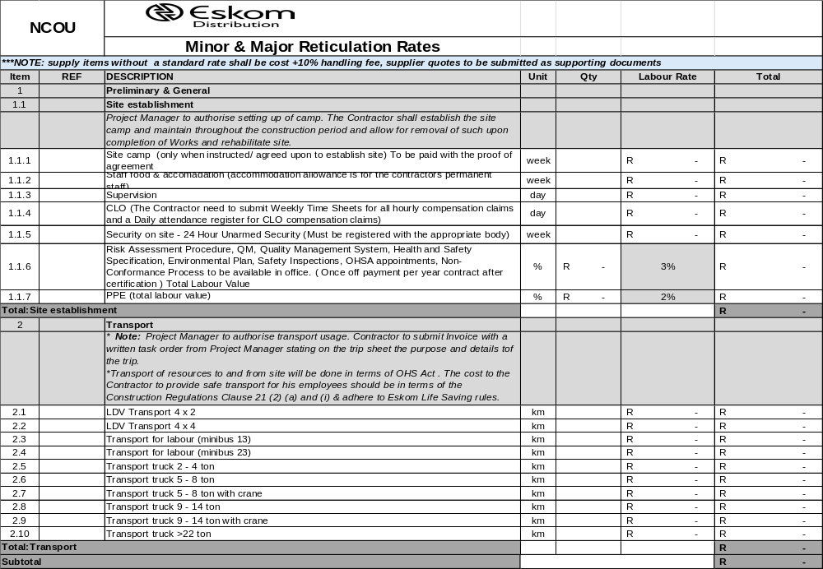
PRICE SCHEDULE – SECTION 1-2 (P&Gs)

Slide 7
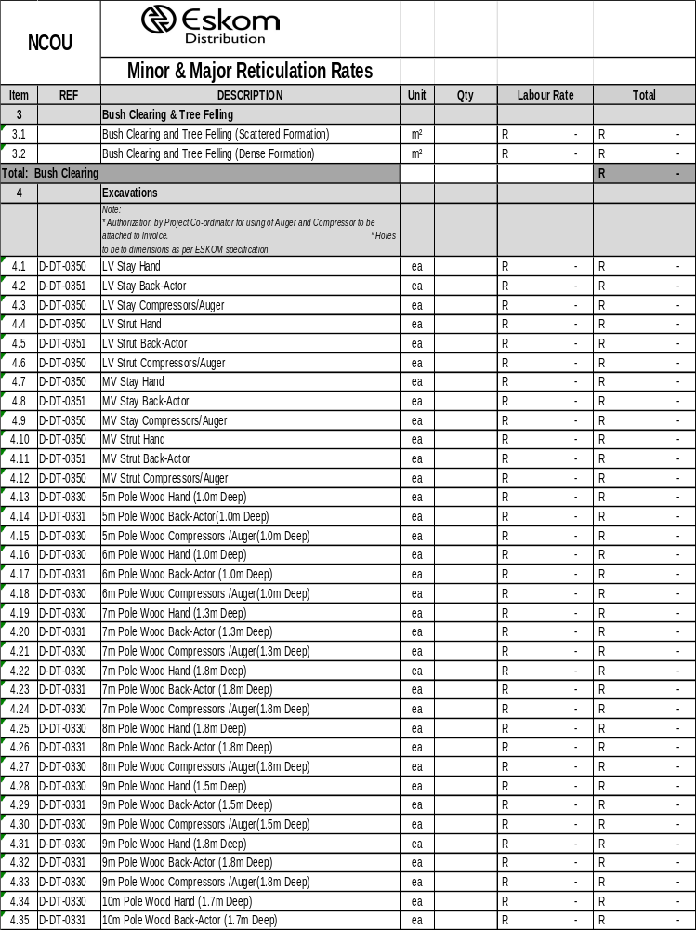
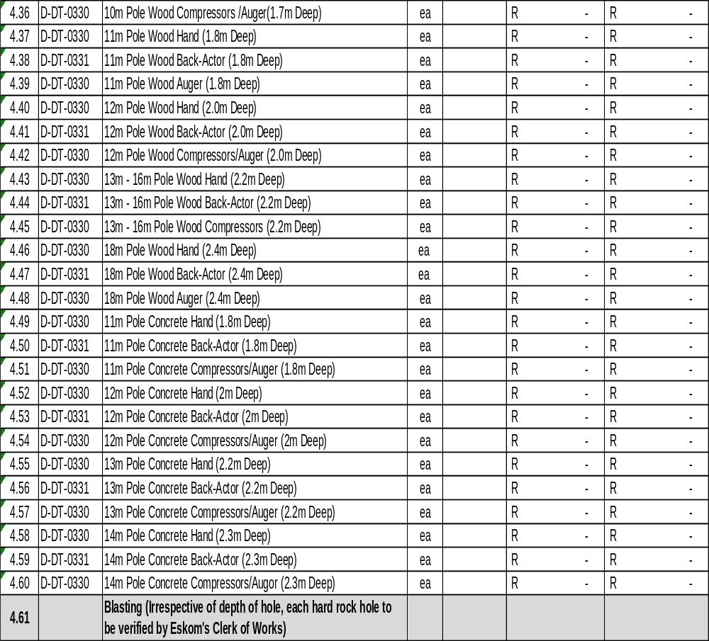
PRICE SCHEDULE – SECTION 3-30 (Labour)

Slide 8
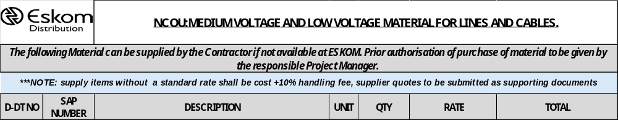
PRICE SCHEDULE – SECTION 31 (Material)
Material will be provided by Eskom, however in the case where the Eskom store has a deficit, the appointed contractor will be requested to supply material on an (“as and when required”) basis with a 10% handling fee.

Slide 9
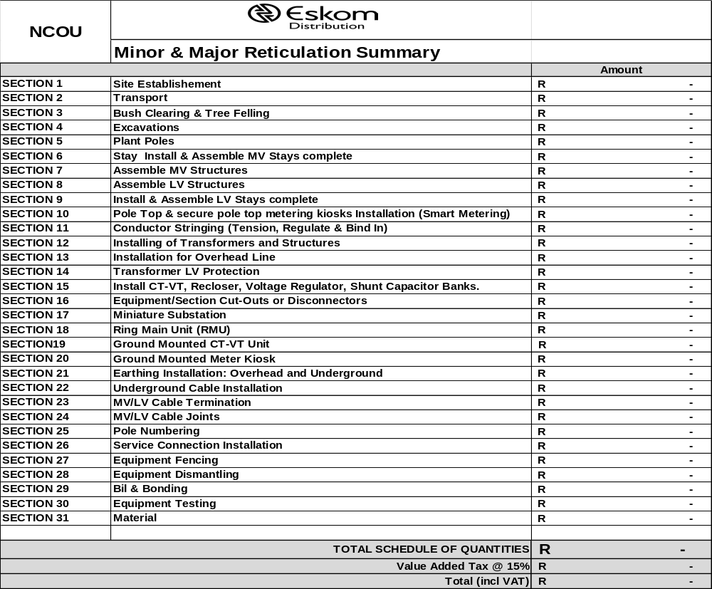
PRICE SCHEDULE – SECTION - Summary

Slide 10
PRICE SCHEDULE
1. Material will be provided by Eskom, however in the case where the Eskom store has a deficit, the appointed contractor will be requested to supply material on an (“as and when required”) basis with a 10% handling fee.
2. The contract will be on an as and when required basis to multiple suppliers.
3. Tenderer to propose rates for all items.
***NOTE :

Slide 11
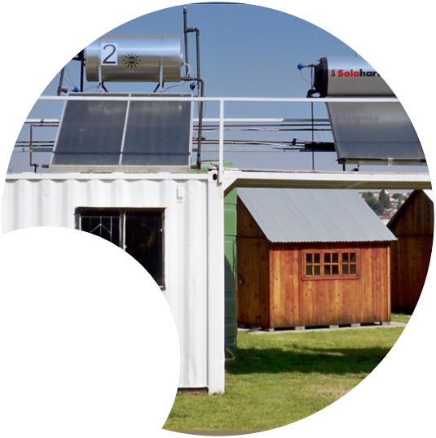

.
Thank you
28.08.2026

