Slide 1

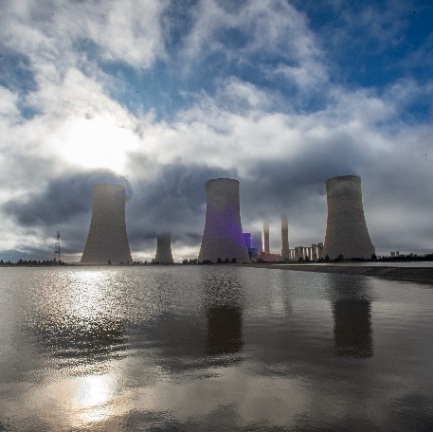
Non-compulsory clarification meeting/site visit
Ash Giant Mixer Conditioner Refurbishment over a period of five (5) years on an as-and-when required at Matimba Power Station
Officer Procurement : Azwifaneli Thagwana
Matimba Power Station, Auditorium

Slide 2
Agenda
No. | Subject | Presenter
1. | Opening: 1.1 Welcome 1.2 Apologies and quorum | Chairperson
2. | Safety and Emergency Evacuation Procedure | Safety Rep
3. | Declaration of Interest (Eskom Rep and Suppliers Rep) | All
4 | Matters for Discussion
4.1 | E3430GXLPMAT Invitation to Tender - Ash Giant Mixer Conditioner Refurbishment over a period of five (5) years on an as-and-when required at Matimba Power Station. | Chairperson
4.2 | (Technical Evaluation) Mandatory and Qualitative Evaluation | Technical Team
4.3 | Quantity Surveyor | QS rep
4.4 | SDL&I | SDL& I rep
4.5 | SHEQ (Occupational Health and Safety, Environmental and Quality Requirements) | SHEQ Reps
5 | General (before Viewing of site) | All
6 | Viewing Site at Matimba Power Station for Ash Giant Mixer Conditioner | Technical and All

Slide 3
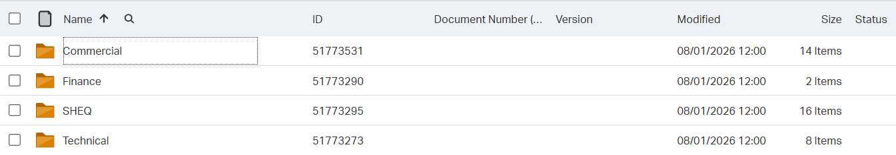
Submission of commercial Documents: Invitation to Tender
https://etendering.eskom.co.za
Folders of submission
Commercial – fully Completed ITT, CSD report, Coida, BBBEE, and E-tendering acknowledgement.
Finance – fully completed NEC TSC3 with the price schedule and Audited financial statements.
SHEQ & SDL&I
Technical
As indicated Below:

Slide 4
ITT Page to be noted:
Page No.1
Closing date and time 25/09/2026
Tender validity period 180 days from the closing date and time
2.7-.2.11 Submitting a tender
All documents need to be submitted in a PDF format (The upload size per document is 500 megabytes and total submission is restricted to 4 gigabytes). The price list needs to be submitted in PDF and a copy in excel format.
No Zip/condense files can be uploaded
No hard copy will be accepted
Page No. 28 – 32 (Commercial Evaluations Checklist)
Returnable required at Tender closing (disqualifiable)
Returnable required at Tender closing (Non-disqualifiable)
Returnable required prior to contract Award.

Slide 5
Basic compliance submission
Fully completed ITT.
Fully completed NEC3 ECC.
Technical folder as part of the submission.
SHEQ folder with their requirements as well.
Due Diligence/financial analysis.

Slide 6
(Technical Evaluation) Mandatory and Qualitative Evaluation)
Qualitative Technical Evaluation Criteria
The minimum weighted final score (threshold) required for a tender to be considered from a technical perspective is 70%.
Technical Mandatory requirements:
Item | Mandatory Technical Criteria Description | Reference to Technical Specification / Tender Returnable | Motivation for use of Criteria
1 | Ownership/ access to a workshop with steel fabrication machines | Submit proof of ownership/access to a workshop that will be used to refurbish the conditioners with steel fabrication machines, the proof should include: 1. Proof of lease/title deed/ownership of the workshop facility with a floor size greater than 500 m² OR Proof of partnership with workshop facility floor size greater than 500 m² 2. Certificates and images of workshop machines: 10-ton overhead crane, CO₂ welders, sheet metal roller and gelatine. Mandatory site visits will be conducted by TET evaluators for verification. Non-compliance or false information will lead to disqualification. | It is mandatory that the service provider can have access to a workshop for efficient refurbishment of the conditioners. Incompetence will compromise the quality of the refurbishment; delays will slow down on production and return to service times for the conditioners.

Slide 7
Qualitative technical evaluation criteria
Qualitative Technical Criteria Description | Tender Returnable(s) | Sub Weighting (%) | Scoring Criteria
Company profile and proven experience in conditioner/giant mixer overhaul and refurbishment. Attach the following as proof: Company Profile with Company record proving technical expert works undertaken and organogram depicting company resources and following: 2. Contract number with SOW with defects clearance certificate for completed projects OR 3. Purchase order number with SOW with defects clearance certificate for completed projects OR 4. Completion certificate with SOW with defects clearance certificate for completed project. | Section 3.2 - Table 2 – Item 2 | 60% | COMPLIANT: Score = 5 (100%). 5 years or more proven experience
 |  |  | COMPLIANT WITH ASSOCIATED QUALIFICATIONS: Score = 4 (80%). 4 years proven experience
 |  |  | NON-COMPLIANT: Score = 2 (40%). Less than 3 years proven experience
 |  |  | TOTALLY DEFICIENT OR NON-RESPONSIVE: Score = 0 (0%). No experience/minimum qualification/response

Slide 8
Qualitative technical evaluation criteria
Qualitative Technical Criteria Description | Tender Returnable(s) Sub Weighting | Sub Weighting (%) | Scoring Criteria
Detailed ash conditioner refurbishment programme | Section 3.2 – Table 2 - Item 4 | 10% | COMPLIANT: Score = 5 (100%). Submitted and detailed with tasks including man hours. The method statement and QCP are aligning
 |  |  | NON-COMPLIANT: Score = 2 (40%). Submitted but not detailed
 |  |  | TOTALLY DEFICIENT OR NON-RESPONSIVE: Score = 0 (0%). Not submitted

Slide 9
Qualitative technical evaluation criteria
Qualitative Technical Criteria Description | Tender Returnable(s) Sub Weighting | Sub Weighting (%) | Scoring Criteria
Method statement for refurbishment of conditioners | Section 3.2 – Table 2 - Item 5 | 15% | COMPLIANT: Score = 5 (100%). Submitted and technically adequate with all the necessary steps and sequence.
 |  |  | NON-COMPLIANT: Score = 2 (40%). Submitted but not technically detailed
 |  |  | TOTALLY DEFICIENT OR NON-RESPONSIVE: Score = 0 (0%). Not submitted

Slide 10
Qualitative technical evaluation criteria
Qualitative Technical Criteria Description | Tender Returnable(s) Sub Weighting | Sub Weighting (%) | Scoring Criteria
Quality control procedure (QCP) for conditioner refurbishment | Section 3.2 – Table 2 - Item 8 | 15% | COMPLIANT: Score = 5 (100%). Submitted and aligning with the method statement
 |  |  | NON-COMPLIANT: Score = 2 (40%). Submitted but not aligned with the method statement
 |  |  | TOTALLY DEFICIENT OR NON-RESPONSIVE: Score = 0 (0%). Not submitted

Slide 11
Quantity Surveyor
C2.2 the activity schedule as per the NEC3 ECC provided
Item No. | Description | Unit | Quantity | Amount | Total in 60 Months
1 | Major Refurbishment | Sum | 1
2 | Minor Refurbishment | Sum | 1
3 | Spares | Sum | 1
Total Amount

Slide 12
SDL&I
SDL&I
SBD 6.1 PREFERENCE POINTS CLAIM FORM IN TERMS OF THE PREFERENTIAL PROCUREMENT REGULATIONS 2022 BBBEE
B-BBEE Status Level of Contributor | Number of points (90/10 system)
1 | 10
2 | 9
3 | 6
4 | 5
5 | 4
6 | 3
7 | 2
8 | 1
Non-compliant contributor | 0

Slide 13
SDL&I
Objective criteria are applicable. Please note that Eskom may award the contract to a tenderer other than the highest scoring if objective criteria justify the award. The following objective criteria apply to the tender: Objective Criteria that SDL&I This tender concerns a service that has material and commodities that are part of the designated sector as per regulation. Therefore, only locally produced goods or services with a stipulated minimum threshold for Local Production and Content will be considered. Therefore SBD 6.2 and supporting annexures WILL form part of tender returnable. Local Procurement Content Tender will stipulate local procurement content for the works Subcontracting
Material | Threshold%
Valves | 70%
Fasteners | 100%

Slide 14
SDL&I
The winning tenderer is encouraged to procure/spend on designated groups from rural / underdeveloped / township.
Returnable
Letter if intent to subcontract.
Skills Development
The SD&L Matrix is not an evaluation criterion; however, Tenderer are encouraged to make proposals before they are eligible for award in accordance with develop the skills in line with the SOW as illustrated on a below table. Skills development candidates should be from Lephalale Municipality area
Procurement from designated group | Eskom Target
Black Owned | 20%
Skills type | Eskom target | Entry Level | Output | Tenderers Proposal
Mechanical Technician | 1 | Diploma / N Diploma | On job Training

Slide 15
SHEQ (Occupational Health and Safety, Environmental and Quality Requirements)
Occupational health and Safety
Contractual requirements mean all suppliers must submit the OHS returnable on the tender closing date. OHS will evaluate the suppliers that have passed functionality and mandatory. The suppliers who have not submitted all the requirements or the compliance standards is not satisfactory, OHS will request the outstanding documents from the suppliers only once through the buyer. The suppliers will be given 7 working days to respond to the request. The suppliers that responded within the stipulated time will be re-evaluated, failure to submit the outstanding document will be rendered non-responsive. The evaluation report will be submitted to procurement. This Safety requirements are for OHS (Occupational Health and safety)
Annexure B- Is the acknowledgement of Eskom's OHS legal and other requirements form signed and submitted by the tenderer?
Health and Safety Plan- (must address the project /scope of work OHS risk(s) and aligned with the health and safety specification or requirements)
Costing for Health and Safety management - Has the tenderer submitted detailed costing for OHS (the cost should be broken down not provided as a lump sum)
- The costing must be based on the overall scope of work/service to be performed
- The scope of work and the risk assessment may serve as a guideline
Valid Letter of Good Standing (COIDA or equivalent)
OHS policy signed by CEO- The submitted policy must comply to OHS Act Section 7
OHS Competency - (Consider scope of work, risks, OHS plan and applicability) CV, s and qualifications / certificates (List competencies required)

Slide 16
Environmental requirements
No. | Description | Relative weight score | Compliance Criteria
1 | Environmental Policy the policy statement should commit to: (1) environmental compliance and (2) duty of care or pollution prevention commitments | 10 | Signed policy statement committing to environmental compliance and duty of care = 10 Signed policy statement not addressing environmental compliance and duty of care or no policy submitted = 0
2 | Aspects and Impacts Register Provide Aspects and Impacts register related to the scope of work | 70 | A&I register identifies, assesses and provodes controls/ mitigations for impacts as per scope of work (85-100%) = 70 A&I register has not fully identified/ assessed aspects and impacts as per scope of work. Environmental impacts are partially mitigated (35-50%) = 35 A&I register not submitted or not aligned with the scope of work (1-35%) = 0
3 | Method Statement (MS) Adequate understanding of the project as a whole, and methodology reflect this. Does it give an indication that the scope of work has been catered for appropriately? | 20 | The method statement should fully demonstrate the scope of work to be executed (85-100%) = 20 The method statement partially demonstrate the scope of work to be excuted (35-50%) = 10 Method statement not submitted or not demonstrating the scope of work to be executed = 0
Total Weight Score |  | 100

Slide 17
Quality requirements.
Category 2: Quality Requirements Deliverables to be evaluated indicator = 1
 |  | Apply =1
SECTION A: Quality Management System Requirements ISO 9001 (Option 1) Valid certification of Quality Management System by an ISO accredited body | A.1 Product / Service Scoping on ISO 9001 certificate is defined and relevant | 1
 | A.2 Certificate by Approved and Authorized certification authority | 1
 | A.3 Certification Authority has Recognized International Accreditation | 1
 | A.4 Validity (expiry date) of certificate | 1
Section A Score Option 1 |  | 4
SECTION A: Quality Management System Requirements ISO 9001 (Option 2) Objective evidence of documented QMS that is not certified but complies with ISO 9001 | A.1 QMS Manual or a document that defines and describes the QMS and its scope | 1
 | A.2 Quality Policy Approved by top management. | 1
 | A.3 Quality Objectives Approved by top management. | 1
 | A.4 Control of documented information (i.e. document and record control) Clause 7.5 of ISO 9001:2015 | 1
 | A.5 Documented information for Control of nonconforming outputs Clause 8.7 of ISO 9001:2015 | 1
 | A.6 Documented information for Nonconformity and Corrective action Clause 10.2 of ISO 9001:2015 | 1
Section A Score Option 2 |  | 6
SECTION B : Evidence of QMS in operation (Tender Quality Requirements -Ref 240-105658000) | B.1 Documented information for defined roles, responsibilities and authorities - Organization chart and Responsibility matrix (must include but not limited to quality management function/role) (Clause 5.3 of ISO 9001:2015) | 1
 | B.2 Documented information for Control of Externally Provided Processes, Products and Services - Must include criteria for evaluation, selection, monitoring of performance, and re-evaluation of external providers (Provide a copy of process/procedure regarding the assessment, selection, management and auditing of suppliers and subcontractors with supporting evidence (reports or records of how his process was implemented) (Clause 8.4 of ISO 9001:2015) | 1
Section B Score |  | 2
SECTION C: Contract Quality Plan Requirements (Ref 240-105658000 and 240-109253698). Draft Contract Quality Plan specific to the scope of work as described in the tender documents (Ref ISO 10005) | NB! Draft Contract Quality Plan that has important Quality Assurance deliverables A provisional Contract Quality Plan (CQP) specific to the Ash Giant Mixer Conditioner refurbishment contract. The CQP must demonstrate how the tenderer will manage quality assurance for refurbishment, supply of spares, fabrication, machining, welding, painting, assembly, packaging, transportation and any subcontracted work. The CQP must clearly define roles, responsibilities, inspection authority, document control, quality records, non-conformance control, corrective actions, resource allocation and Eskom verification points throughout the five-year as-and-when-required contract period. | 1
Section C Score |  | 1
SECTION D: Quality Control Plan Requirements (Ref 240-105658000 or 240-109253302) QCP /Checklist/ ITP (Quality Control Plans) as per Scope of Works (Ref ISO 10005) | NB! Draft/ Example of an Inspection and Test Plan (ITP) or Quality Control Plan (QCP) on similar and/ or previous work done. A provisional Quality Control Plan (QCP) or Inspection and Test Plan (ITP) relevant to the Ash Giant Mixer Conditioner refurbishment scope. The QCP must include inspection and verification activities for strip-and-assess, dimensional checks, material verification, fabrication, machining, welding, replacement of liners, seals, bearings, gears, shafts, paddle blades, spray water system components, sandblasting and painting, final assembly, packaging and delivery. The QCP must identify applicable standards, acceptance criteria, records to be submitted, Hold and Witness points for Eskom verification, and alignment with the refurbishment programme and method statement. | 1
Section D Score |  | 1
SECTION E: User defined additional Requirements & miscellaneous (Ref 240-105658000) Customer specific requirements & other standards and required can be listed and evaluated here | E.1 Form A is completed and signed. | 1
Section E Score |  | 1

Slide 18
Q&A
If there is no questions, clarification question can be addressed to thagwaaf@eskom.co.za or contact me on 014 763 8690
2.16 Seeking clarification - The tenderer will notify Eskom of any clarifications required before the closing time for clarification queries, which is 5 working days before the deadline for tender submission.

Slide 19
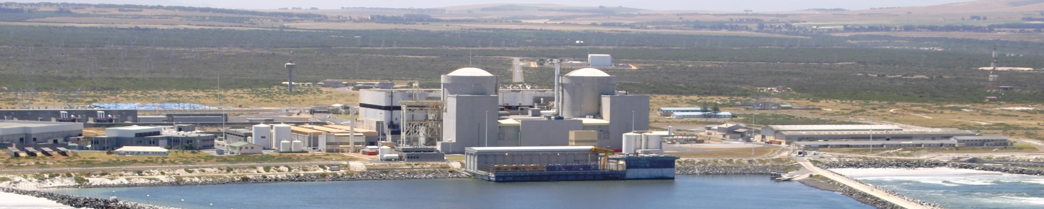
Thank you/ Ri khou livhuwa

