Slide 1
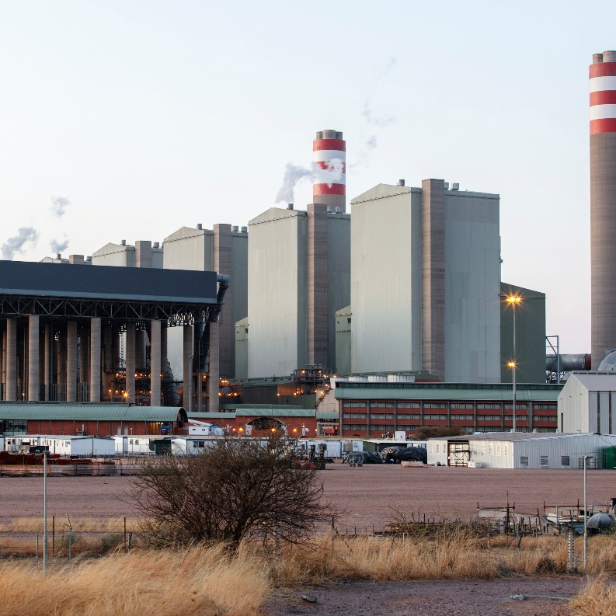
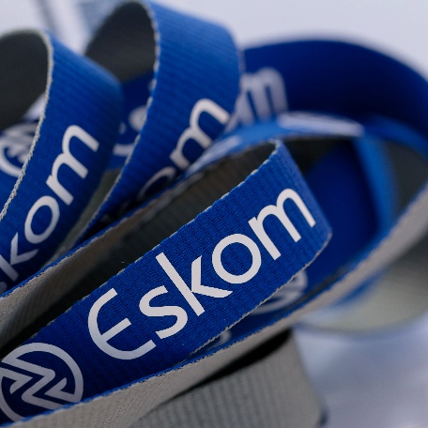

Eskom’s requirements for the pricing of imported goods/services and the Eskom Payment Methods applicable.

Slide 2
Eskom’s requirements for the pricing of imported goods/services and the Eskom Payment Methods applicable.
Introduction
Eskom, as is any other company in South Africa, required to comply with the South African Reserve Bank Exchange Control Regulations regarding:
- the flow of currency in/out of South Africa
- the hedging of foreign currency exposures.
Eskom also has an internal policy on the management of any exchange rate risk which may exist in any agreements entered with suppliers/contractors.

Slide 3
Eskom’s requirements for the pricing of imported goods/services and the Eskom Payment Methods applicable.
A pricing schedule in the form of a price list, activity schedule or BOQ list is issued with the tender.
Should a tenderer have any imported content, and the pricing and payment thereof is in foreign currency or ZAR pricing where the ZAR amount to be paid is linked to a foreign currency exchange rate:
The tenderer must be the direct importer of the goods/services to be supplied as per the tender requirements (refer to Exchange Control circular 14/2024).
Foreign Currency and Foreign currency amounts must be clearly indicated in the tender submission
The exchange rate to be used for the tender must be the exchange rate as published on the South African Reserve Bank website (www.resbank.co.za) on the date that the tender was advertised.
.

Slide 4
Eskom’s requirements for the pricing of imported goods/services and the Eskom Payment Methods applicable.
Not all currencies traded globally have a forward cover market to hedge exchange rate risk, so should a tenderer opt to price in a currency not listed below, they need to confirm with Eskom BEFORE tender close, whether the foreign currency they wish to price in, is acceptable to Eskom.
Currency Description | Curerncy Code
South African Rans | ZAR
Australian Dollar | AUD
Canadian Dollar | CAD
Swiss Franc | Chf
Chinese Yuan | CNY/CNH
Danish Krone | DKK
Europena Currency | EUR
British Pound | GBP
Hong Kong Dollar | HKD
Japanese Yen | JPY
Norwegian Krone | NOK
Swedish Krone | SEK
Singapore Dollar | SGD
United States Dollar | USD

Slide 5
Eskom’s requirements for the pricing of imported goods/services and the Eskom Payment Methods applicable.
Should a tenderer submit pricing for imported goods/services in a foreign currency or a ZAR price inked to rate of exchange movement:
There are 4 Payment Methods which a tenderer may select from for payment of the imported goods/services. Eskom will not consider any alternative to the 4 proposed payment methods.
For each of the Payment Methods, the requires that the tenderer (who will then become the contracting party), must be the direct importer.
Payments using the Eskom Payment Methods require that , the tenderer must provide a Commercial (overseas) Invoice, Local Tax invoices and proof of importation.
Where tenderers cannot supply Eskom with a Commercial Invoice and proof of importation, the pricing to Eskom must be in ZAR with Eskom not being liable for any foreign currency exchange rate exposure.
.

Slide 6
Eskom’s requirements for the pricing of imported goods/services and the Eskom Payment Methods applicable.
The following are the only Payment Methods that Eskom will consider for payment of the imported goods/services:
Payment Method 1A (payment in foreign currency directly overseas)
Payment Method 1B (payment in foreign currency into a local CFC account)
Payment Method 2 (payment in ZAR linked to a rate of exchange)
Payment Method 3 (payment in ZAR at an agreed rate of exchange: supplier assumes the exchange rate risk)
If the tenderer is not the direct importer of the imported goods/services and/or cannot submit a Commercial (overseas) invoice for payment purposes, their pricing to Eskom must be in ZAR with no exchange rate risk for Eskom’s account. Eskom will not accept any exchange rate risk in these scenarios.
.

Slide 7
Eskom’s requirements for the pricing of imported goods/services and the Eskom Payment Methods applicable.
Payment Method 1A
Eskom makes payment in foreign currency directly overseas to the nominated foreign beneficiary.
Payment Method 1A has 2 scenario’s:
Eskom transacts directly with an overseas supplier and pays them directly
Eskom contracts with a local supplier who indicates that payment must be made to a nominated overseas beneficiary.
In this scenario the Commercial Invoice is made out to Eskom, and the payment beneficiary must be indicated in the contract between Eskom and the local supplier.
For both scenarios, the banking details of the beneficiary need to be supplied and proof of importation will be required and the payment documentation should be indicated in the contractual agreement ..
Requirements:
Eskom to be provided with the banking details of the overseas beneficiary of the foreign payment.
Contracting party to supply proof of importation.
The contracting party must be the direct importer
The payment details must be indicated in the Secondary Clause X3 (Multiple Currencies) of the contractual agreement.
.
.

Slide 8
Eskom’s requirements for the pricing of imported goods/services and the Eskom Payment Methods applicable.
Payment Method 1B
Eskom will pay a local supplier in foreign currency into the contracting party’s CFC (Customer Foreign Currency ) bank account.
Requirements:
Eskom will require documentary evidence of the approval application made to the Reserve Bank and the official response from the Reserve Bank. (response from Reserve Bank must be on a SARB on SARB’s letterhead. NO copy and paste).

Slide 9
Eskom’s requirements for the pricing of imported goods/services and the Eskom Payment Methods applicable.
Payment Method 1B (continued)
Requirements (continued):
The commercial (overseas) invoice and a local tax invoice required to be submitted at time of payment request. The foreign currency amounts on both invoices must be the same. This is in line with SA Reserve Bank requirements. Eskom will not pay profit in foreign currency.
Please note: the commercial invoice used in the clearance of the imported goods must be from the country of origin.
The Contracting party must be the direct importer.
Eskom requires proof of importation by the contracting party
Payment details to be indicated in Clause X3.1 of the contract.
.
.

Slide 10
Eskom’s requirements for the pricing of imported goods/services and the Eskom Payment Methods applicable.
Payment Method 2
This is a ZAR based payment linked to an exchange rate movement. This payment method is only applicable for the procurements of goods.
Eskom will hedge the exposure and payment to the supplier will be done at the spot rate of exchange at which Eskom sells the forward cover in the market.
Requirements:
This Payment Method is only applicable for the payment for goods, not for service-related payments.
Approval for the used of Payment Method 2 needs to be applied for and received from Eskom PRIOR to tender close. If approval is not sought prior to tender close, one of the other payment methods must be selected.

Slide 11
Eskom’s requirements for the pricing of imported goods/services and the Eskom Payment Methods applicable.
Payment Method 2 (continued)
Requirements (continued):
Although payment is ultimately in ZAR, due to the ZAR value being linked to a rate of exchange, Eskom will require proof of importation by the contracting party.
The contracting party must be the direct importer
Payment details and payment documentation required to be indicated in Clause X3.1 of the contract.

Slide 12
Eskom’s requirements for the pricing of imported goods/services and the Eskom Payment Methods applicable.
Payment Method 3
ZAR payment made at an exchange rate agreed by Eskom and the supplier.
Eskom will allow the tenderer to hedge the exchange rate movement by means of forward cover.(This means that the supplier takes the foreign currency and/or exchange rate risk for the full exposure of the contract)
However, Eskom will require that a simultaneous exercise is done to ensure that the exchange rates for the tenderer’s forward cover is market related.
Please note: Eskom is not instructing the supplier to hedge the exchange rate risk, that is a decision that the supplier will make in line with their own business risk philosophy. However, once both parties agree on an exchange rate to be used, Eskom will not allow any further exchange rate adjustment.

Slide 13
Eskom’s requirements for the pricing of imported goods/services and the Eskom Payment Methods applicable.
Payment Method 3 (continued)
Requirements:
The contracting party must be the direct importer of the goods/services.
Although payment is in ZAR, because the ZAR value is linked to a rate of exchange, a Commercial (overseas) invoice and proof of importation will be required.
.

Slide 14
Eskom’s requirements for the pricing of imported goods/services and the Eskom Payment Methods applicable.
Important Notice:
If the contracting party is not the direct importer of the goods/services, the pricing to Eskom must be in ZAR with no foreign currency or exchange rate exposure for Eskom.
If the contracting party sources from another local supplier, where the local supplier is the importer, the pricing to Eskom must be in ZAR – with no link to any foreign currency or exchange rate movement.
Exchange rate adjustment/variation cannot be included in a CPA formula.
If foreign CPA is applicable, a Commercial (overseas) invoice will be required for payment of t he foreign escalated value claimed and to be paid.

Slide 15


Thank you
Dankie
Siyathokoza
Re a leboha
Re a leboga
Siyabonga
Inkomu
Ro livhuwa
Enkosi
Siyabonga
Eskom Holding SOC Ltd retains the copyright of the documents and/or designs published for Eskom. No part of this document or design may be reproduced in any manner or form or by any means without Eskom’s written consent. Any unauthorised reproduction of this copyright work in any form or by any means will constitute a copyright infringement and render the person or company liable under both civil and criminal law.
©Eskom Holdings SOC Ltd

