Slide 1
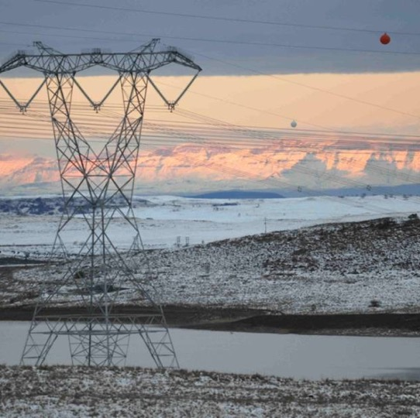

CLARIFICATION MEETING
Enquiry Number: E3387NTCSAMWP
THE SUPPLY, TESTING, DELIVERY AND-OFF LOADING OF POWER LINE CARRIER (PLC) EQUIPMENT
Presented By: TZ Timana
Date: 10 September 2026

Slide 2
AGENDA
1 | Welcoming of Attendees | T Timana | 2 Minutes
2 | Evacuation Procedure | T Timana | 3 Minutes
3 | Introduction of NTCSA Representatives & Suppliers | All | 15 Minutes
4 | Declaration of interest | All | 5 Minutes
5 | Objective of the session | T Timana | 5 Minutes
6 | Commercial | T Timana | 15 Minutes
7 | Technical | T Gosai/R Gangat | 15 Minutes
8 | Finance/ PS5 Schedule/FOREX | M Maluleke/ Z James/ C Strydom | 20 Minutes
9 | Quality, Safety, Environmental | F Mogamisi/M Thulare/P Likhethe | 45 Minutes
10 | Supplier Development, Localisation and Industrialisation (SDL&I) | H Motjiyeng | 15 Minutes
11 | General | All | 15 Minutes

Slide 3
Session Objectives
Session Objectives
Addressing questions on the contents of the invitation to tender E3387NTCSAMWP
Providing a forum for Q & A to clarifications required.

Slide 4
Timelines, Invitation to tender Conditions & Communication
NTCSA Representative for E3387NTCSAMWP :
Name : Thandazile Timana
E-mail : TimanaTZ@ntcsa.co.za
Landline : +2711 516 7607
Timelines
Non-Compulsory Clarification meeting : 10 September 2026
Clarification Queries Closing Date : Five (05) working days prior to tender closing (including requests for extensions)
Enquiry Closing Date and Time : 30 September 2026, Strictly 10:00am (SAST)
No Late Submission/s will be accepted under any circumstances- Not even by a second

Slide 5
Timelines, Invitation to tender Conditions & Communication
All questions and clarifications pertaining to this enquiry will be in writing only and addressed via email to the NTCSA Representative.
No responses to individual suppliers. All responses will be uploaded on the National Treasury e-tender portal and NTCSA tender bulletin only.
Escalation of ITT issues to NTCSA Chief Executive or Eskom Group Chief Executive is an avenue of last resort and Tenderers should refrain from escalating ITT issues to this level and should rather submit such to the individuals specified on the ITT (page 16 of 72, point 1.1)
Tenders are to be submitted electronically via Eskom E- tendering site by the stipulated closing date and time.
Tender Returnables (To be submitted at tender closing):
* Returnables required at Tender closing (disqualifiable).
** Returnable required at Tender closing (non-disqualifiable) – Tenderers afforded 5 days to submit from request date
# Returnables required at Tender Closing date and time for evaluation

Slide 6
Tender Conditions
The tender will be for the whole or part of the contract.
Whole refers to the supply, testing, delivery and-off loading of all items on the forecast as issued in the tender.
Part denotes some items for the full value chain i.e. supply, testing, delivery and-off loading of some of the items.
Award: the contract up to the highest-ranked supplier in proportion to the PPPFA scoring.
Proof of CSD registration:
If a tenderer's Central Supplier Database (CSD) status is non-compliant at the time of contract award, the tenderer shall be afforded a period of seven (7) calendar days to remedy such non-compliance and provide proof thereof. Should the tenderer fail to achieve CSD compliance within the prescribed period, NTCSA reserves the right, to revoke the contract award and proceed with any other remedy available in law.

Slide 7
Tender conditions
The tender validity period is 31 weeks from tender closing date and time. Should this be extended tenderers agreeing to the request will not be required or permitted to modify a tender. If a tenderer modifies a tender, such a tender will be disqualified from the evaluation process.
No alternative tenders.
Specific goals will be scored out of 20 or 10 points in accordance with the PPPFA. If a tenderer fails to submit evidence of its points claim for a Specific Goal, it will not be disqualified. However, it will be awarded 0 points for that Specific Goal.
Price points: Either 80/90 will apply.
Ranking: Pricing points and Specific goals points will be added together to rank suppliers (2 decimal points).
Objective criteria applicable: Designated Material, Subcontracting & SDL& I objectives.
Functionality is applicable
Contractual requirements applicable: Proof of CSD registration, Financial analysis, Safety, Environmental and Quality. Contractual Requirements are not evaluation criteria - assessed after the evaluation and ranking of the tenders. Proof that the tenderer recommended for award has met the stipulated contractual requirements must be submitted prior to contract award
Contractual Conditions: NEC3 Supply Contract

Slide 8
Electronic Tender Submissions
The tenderer must upload the Invitation to tender via NTCSA Tender bulletin site on the Eskom E- tendering page. The documents uploaded under the folders: Technical, Commercial, Financial, Quality and other.
All documents need to be submitted in a PDF and Excel format (The limit is 50MB per file and total submission of 900MB per submission).
The price list to be submitted in PDF (signed) and a copy in excel format.
No Zip/condense files can be uploaded
No hard copy files submitted to NTCSA will be accepted, any hardcopy files submitted will be regarded as non-responsive and will be disqualified and not evaluated further.
Any resubmission, the latest version of the invitation to tender submitted will only be accepted and all previous submission/s will be null and void.
Please ensure that the submission status is indicated as complete.
Supplier Help Manual guide and video can be found on Eskom E-tendering page
Note: Supplier’s responsibility to ensure that the tender submission is uploaded timeously.

Slide 9
Evaluation of Tender
Evaluations comprise four (4) steps as follows:
Basic compliance: Assess tender responsiveness
Functionality -
Price and Preference
Objective Criteria ( Contractual requirements)

Slide 10
Evaluation of prices
Prices will be evaluated as follows:
Inclusive of VAT;
Corrected for arithmetical errors;
Excluding contingencies in any bill of quantities or activity schedule’
Adjusted for any other acceptable variations, deviations, or alternative tenders submitted; and
Making a comparison of the Net Present Value of each adjusted tender based on the tendered programme (if provided) and prices, on the estimated effect of Price Adjustment Factors and rate of exchange fluctuations (if applicable) and on other evaluation parameters relating to uncertainty and risk, where applicable.
Unconditional discounts will be taken into account for evaluation purposes.
Conditional discounts will not be taken into account for evaluation purposes but will be implemented when payment is effected.

Slide 11
Important to note
Tax compliance: If not compliant, tenderer will be afforded 7 days to resolve with SARS, failure to do so will result in disqualification.
Quality Compliance: If not compliant, afforded 7 days to comply and resubmit – if non complaint, become conditions of contract and may be disqualified.
Price Evaluations – Standard conditions vs. ITT – ITT take precedence.
Addendum will be uploaded with some technical changes re: sample evaluation.
Escalation of ITT issues to NTCSA Chief Executive or Eskom Group Chief Executive is an avenue of last resort and Tenderers should refrain from escalating ITT issues to this level and should rather submit such to the individuals specified on the ITT (page 16 of 72, point 1.1)

Slide 12
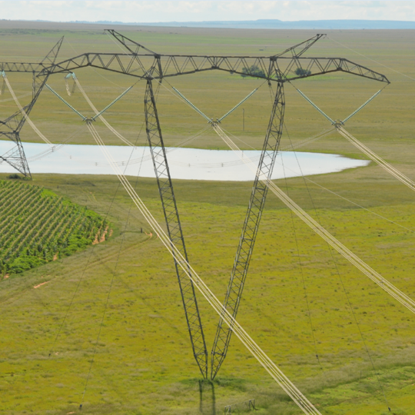
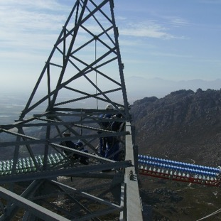
Conclusion

Slide 13

Q&A
Questions?

