Slide 1
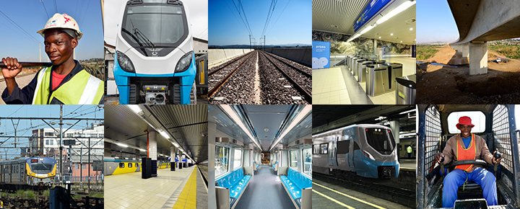

Maintenance Equipment of the New EMUs
APPOINTMENT OF A SERVICE PROVIDER FOR THE DESIGN, MANUFACTURE, DELIVERY, OFF-LOAD, INSTALLATION, TEST AND COMMISSIONING, TRAINING AND MAINTENANCE OF THREE (3) ROLLING
STOCK MOBILE WHEEL LATHE MACHINE FOR PRASA NEW TRAINS
19 August 2026

Slide 2
Background
PRASA’s Rolling Stock Fleet Renewal Programme has delivered over 330 EMU trainsets to date.
This new Rolling Stock fleet requires new or refurbished maintenance depots and modern servicing facilities.
The long-term solution is to modernise and upgrade PRASA’s Rolling Stock maintenance depots through a Depot Modernisation Programme (DMP).
The Mobile wheel lathe with Synchronised lifting jacks is part of the medium-term intervention solution to address the much needed safety maintenance intervention for the EMU’s wheels.

Slide 3
Technical Requirements: Mobile Wheel Lathe Machines
The scope of work for this project shall entail the following activities:
Design
Manufacture
Deliver and Off-Load the Mobile wheel lathe machine at the depot and place it into the workshop where the re-profiling will be conducted
Assemble, Test and Commissioning the machine
36 Months Maintenance program – with an option to extend by 24 months at the sole discretion of PRASA
Training of Maintenance Personnel
Hand-over to PRASA

Slide 4
Technical Requirements: Mobile Wheel Lathe Machines
Targeted Areas By This Project:
Braamfontein,
Durban Yard and
Salt River Rolling Stock Maintenance Depots.

Slide 5
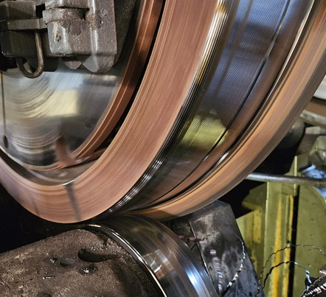
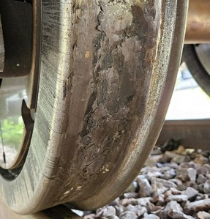
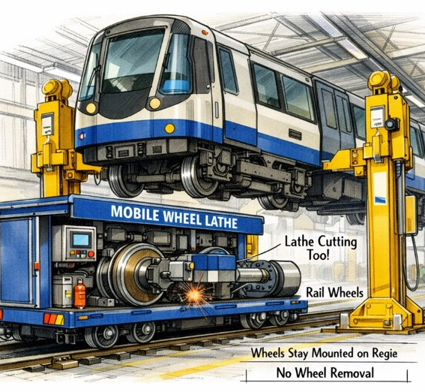
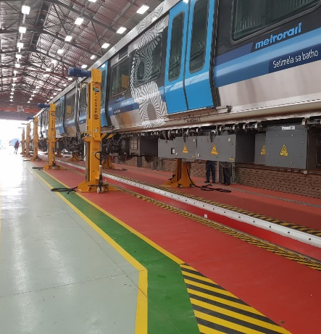
Technical Requirements: Wheel Cutting, EMUs and Workshop

Slide 6
Technical Requirements: Specification of the Work
Product Specification
1.1 User Requirement Specification compliance
Evaluation Capacity of the Bidder
2.1 Track Record Experience
2.2 Delivery Lead Time
2.3 Qualification, Professional registration and Experience of Key Personnel
2.4 Technical Approach and Methodology
2.5 Quality Management Plan / System
2.6 Financial Capability
3. Pre-Award Condition – Site Visit Assessment
3.1 Verification of Capacity and Capability at the Manufacturing Plant (where possible at Client’s premises)

Slide 7
Payment Milestones: Mobile Wheel Lathe
DESIGN, MANUFACTURE, DELIVERY, OFF-LOAD, INSTALLATION, TEST AND COMMISSIONING AND TRAINING OF ROLLING STOCK MOBILE WHEEL LATHE MACHINES FOR PRASA NEW TRAINS
# | Description | Date | % of Works | Amount (VAT Inclusive)
DESIGN, MANUFACTURE, DELIVERY, OFF-LOAD, INSTALLATION, TEST AND COMMISSIONING AND TRAINING OF ROLLING STOCK MOBILE WHEEL LATHE MACHINES FOR PRASA NEW TRAINS
# | Description | Date | % of Works | Amount
1 | Detail Design Approval | [•] | 10% | R [•]
2 | Factory Acceptance Testing (FAT): At source, prior to shipment | [•] | 20% | R [•]
3 | Delivery to site | [•] | 40% | R [•]
4 | Site Acceptance Testing (SAT): Verification against equipment shipped, acceptance and signoff by Engineer/Project Manager | [•] | 20% | R [•]
5 | Release of retention | [•] | 10% | R [•]
Total payments for design, manufacture, deliver, installation, commissioning and training |  | [•] - [•] | 100% | R [•]
MAINTENANCE OF ROLLING STOCK MOBILE WHEEL LATHE MACHINES FOR PRASA NEW TRAINS
# | Description | Date Range | Amount (VAT Inclusive)
1 | Fixed monthly maintenance fee for a period of 36 months | 36 months | R [•]
Total payments for maintenance |  |  | R [•]
Grand Total (Contract Price) |  |  | R [•]

Slide 8
Expected Delivery Schedule: Mobile Wheel Lathe
Milestone | Date
Tender Advert | Early August 2026
Compulsory Tender Briefing | August 2026
Tender Closing Date for Questions | August 2026
Tender Closing Date for Responses | August 2026
Tender Closing Date | Early September 2026
Tender Evaluations (BEC) | September 2026 to October 2026
Bid Adjudication
Tender Approval as per the Delegation of Authority
Award to successful Bidder | October 2026
Contract negotiation and signing of contract | November 2026
Project Implementation to Completion and Hand-Over inclusive of 36 months Maintenance | November 2026 to October 2027 & October 2027 to September 2030

Slide 9
THANK YOU

